Slide 1
Dual Fuel ECDIS
Update
At S-100WG5 we drafted principles of operation for Dual Fuel ECDIS and began discussions on aspects of its operation and how it is supported by standards and stakeholders.

Slide 2
What we said at HSSC
Initial workshops have not identified any major issues with the rollout plan. There will certainly be challenges though.
It is clear that defining the operation of Dual-Fuel ECDIS will require considerable effort from stakeholders across the ECDIS ecosystem and coordination between standards, regulatory and production efforts.
S-100WG and ENCWG has commenced these activities and efforts in industry are also under way.
Efforts will focus on
Better definition of “identical presentation regime” - Portrayal Sub-WG
“Seamless Operation” of DF-ECDIS (S-100WG and others)
ENC Data Production - ENC “Conversion” sub-WG (and others)
HSSC agreed on the Dual-Fuel Concept principles (Essential Principles of Operation) provided in Doc. HSSC12-05.1F… … and tasked S-100WG/S-101PT to liaise with Stakeholders (OEM, etc.) to prepare a governance document that formalizes the guiding principles of DF-Concept for incorporation into the S100 Implementation Roadmap

Slide 3
Dual Fuel ECDIS Definition – A Governance Document
The aim of writing a governance document is to use the principles defined to capture clearly and simply:
S-100 ECDIS
How Dual Fuel ECDIS bridges the gap from now
There is a “simple” explanation of how DF-ECDIS “works” which can be written.
From that:
Promote the benefits of S-100 on the bridge
Define each stakeholder group and the impact on them.
Better define what changes are needed for non-IHO documents and processes
From HSSC.
S-100WG has discussed the concept of dual-fuel ECDIS (DF-ECDIS)
Papers at S-100WG5 proposed “…its operation, data handling and user experience can be made consistent and logical in accordance with the current, relevant standards”
The task at hand is to define better “identical presentation regime” and “seamless operation” in concrete terms

Slide 4
Content and Structure Suggestions
S-100 ECDIS
The expansion of ECDIS to include “S-100” implementation
S-100 contains fundamental re-statements of how “information” is managed
Portrayal and Feature Catalogues
Feature Models (S-101)
Alarms and Indications, Context Parameters
“Data Loading”
Data Protection
Added benefits
“Additional Information” (S-100 product specifications) and its integration (Interoperability)
Update (Catalogues) and Customisation (new product specifications, updated interoperability)
Dual Fuel ECDIS
The ability of an ECDIS to manage both S-57 and S-100 data simultaneously
How data, portrayal and functionality can co-exist

Slide 5
Introduction and Background
History of ECDIS and ENC development
ECDIS stakeholders and their relationships.
Top level definition of the S-100 ECDIS
How S-100 differs from S-57 throughout the data path.
Summary
What is S-100 ECDIS
The Dual Fuel ECDIS concept
IHO Transition period – S-57 to S-100
Data Producers
The transition concept
Supporting transition through co-production
“Coverage” and “Scheming”
Standards (IHO, IMO)
IMO/IEC and IHO standards framework
How the S-100 framework functions to support navigation (+changes)
The IMO concept of the S-100 ECDIS
IMO concepts (minimum test requirements)
Display
Alarms and Indications
Other operations
The path to “S-100 only”
What is “ENC” and “SENC” - Data suitable for primary navigation
Extra Layers, what obscures and what doesn’t (e.g Water Levels)
Arbitrary Data Content
Interoperability
ECDIS Operations
Ingest / Loading
Portrayal, data loading
Co-Display and behaviour of S-57/S-101
Support for ECDIS Operations
Type approval testing
Distribution – IHO data protection scheme
Loading, Ingest, management
“Data Loading” - portrayal
Display and co-Display
Interoperability Operations.
Data Production Support
“ENC is the bare minimum” – considerations with multiple product specifications
“Other products” and their benefits
“What should I produce?”
Transition to S-101/S-57 Co-production
Adoption: initial conversion vs ongoing production
Co-production guidance, coverage, scheming, consistency, validation
Draft content – Governance document.

Slide 6
S-100TSM is asked to:
Note the contents of the paper provided
Approve the creation of an overall Governance document in line with the definitions within the paper and the structure proposed

Slide 7
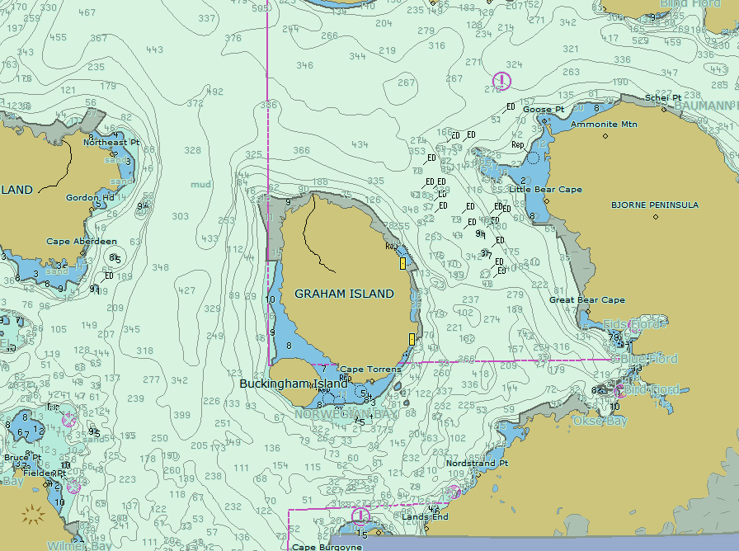
What does an ECDIS actually do?
From IMO:
Chart Loading and Unloading
Update, manual and automated
“Display”
Feature Interrogation
Alerts and Indications
Areas where special conditions exist
Safety Contour Generation.
Route Planning and Monitoring
"Other" functions - those stipulated by the PS.

Slide 8
Principles of Operation - Agreed
Fundamentals:
SOLAS places an obligation on member states to produce and promulgate ENC data to support mandatory carriage of ECDIS. Currently that mandate is fulfilled by the production of S-57.
The addition of S-100 to the IMO PS will allow S-100 data to also satisfy the carriage requirement.
States will provide data which is “safe” using the relevant IHO standards (currently S-57)
Principles:
The principles of a dual fuel ECDIS should be:
It should allow unambiguous and defined import and use of both S-57 and S-101 data. In addition, a selection of S-100 data products should be able to be imported and used to enhance user functionality and safety.
ECDIS behaviour should not be any less “safe” (as defined by the IMO PS) whether S-57 or S-101 data is in use. The requirements of the IMO PS should be met in all eventualities.
User Experience should not be negatively impacted by the introduction of any S-100 data to the ECDIS.

Slide 9
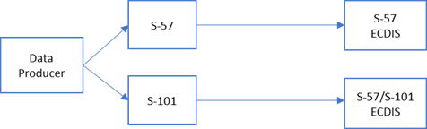
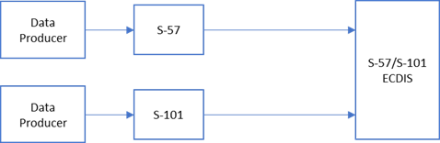
The Transition period
During the transition period:
Data producers will produce data in both S-57 and S-101 forms:
S-57 for (legacy) ECDIS which are unable to process S-101
S-101 for (new) S-100 enabled ECDIS
S-57 in areas where data has not been upgraded to S-101 for BOTH S-100 and S-57 enabled ECDIS
The 2024(neg) date for production of S-101 is the start of (partial) S-101 production by member states (and the operation of infrastructure supporting delivery, testing and support)
Because data producers will need time to migrate entire production holdings to S-101 during the transition period, Dual Fuel ECDIS should accept both S-57 and S-101.

Slide 10
Chart Loading and update
DF-ECDIS suggests a “side by side” approach to loading/update:
The ECDIS loads only S-57 or S-101 for any given area depending on availability, partitioning the SENC into discrete, mutually exclusive areas
Updates always apply to data already in SENC.
S-57/S-101 can overlap but not at same scale (or usage band). Coverage must be unambiguous
Authoritative remains largest scale (CSCL or max display scale)
Partition of SENC seems to be a reliable option
Partition of portrayal
Partition of functionality
Don’t convert data in the ECDIS.
Don’t convert “portrayal” either.
S-101
S-57

Slide 11
Coverage
During the transition period:
Producers must ensure coverage in BOTH S-57 and S-101 for S-100 enabled ECDIS
The ECDIS should not have to load both S-57 and S-101 in the same area at the same scale
If the ECDIS is presented with two charts which overlap at the same scale in the same area then it should load, in preference, the S-101 data – even if that excludes the import of a neighbouring S-57 cell.

